Slide 1
Dijkstra’s Algorithm
SC2001 Project 2

Slide 2
Part A
Input Graph stored in an Adjacency Matrix
Priority Queue: Array

Slide 3
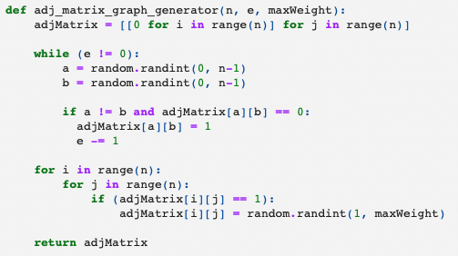
Part A: Random Adjacency Matrix Graph Generator
Graphs are randomly generated, ie randomly generated Adjacency Matrices
n = no. of edges
e = no. of edges with weight

Slide 4
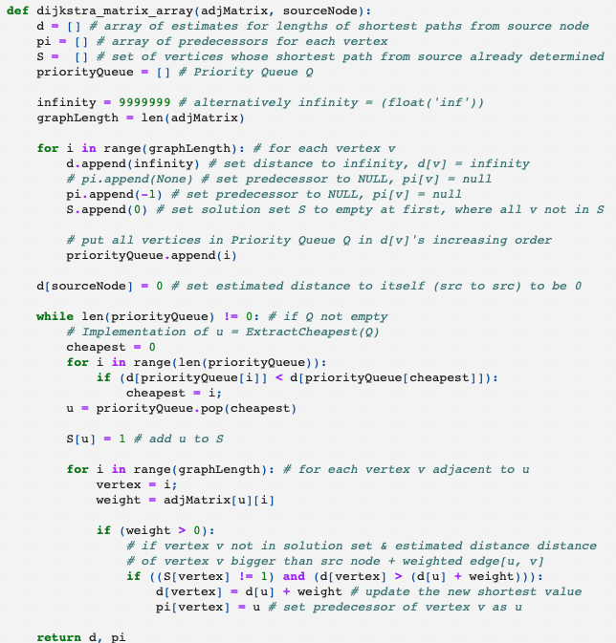
Part A: Dijkstra Algorithm with Array as PQ

Slide 5
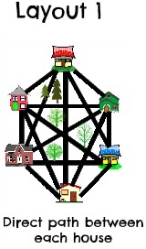
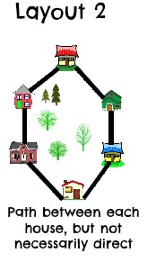
2 Types of Graphs
Complete Graph
Algorithm e = n * (n-1), where e is the maximum number of edges a graph can have
Incomplete Graph
Algorithm e = n + 1

Slide 6
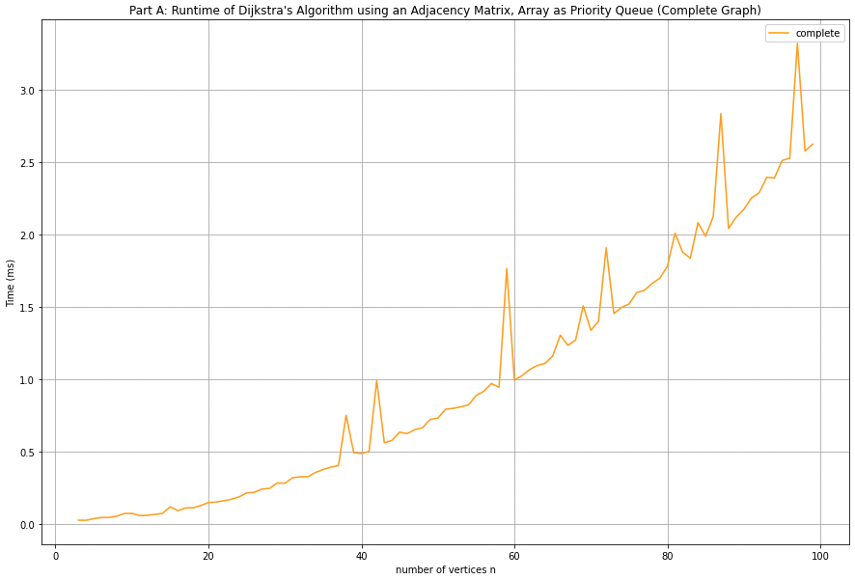
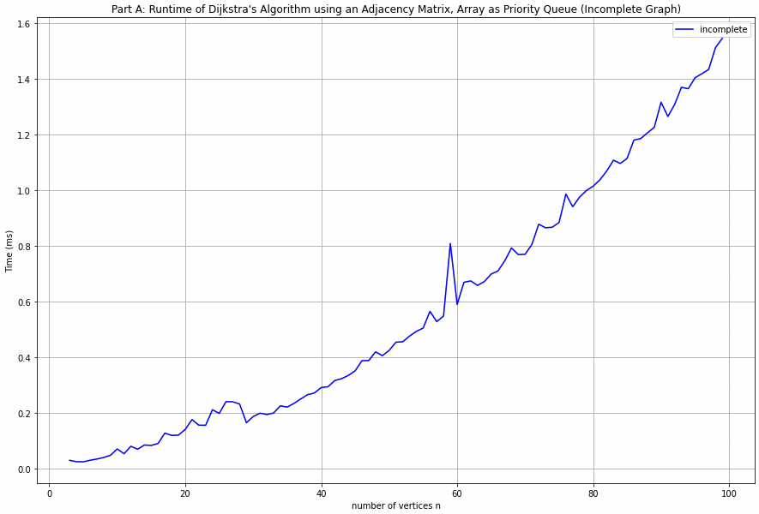
Part A: Dijkstra Algorithm with Array as PQ
Complete Graph
e = n * (n-1)
n = 4 to 100
Incomplete Graph
e = n + 1
N = 4 to 100

Slide 7
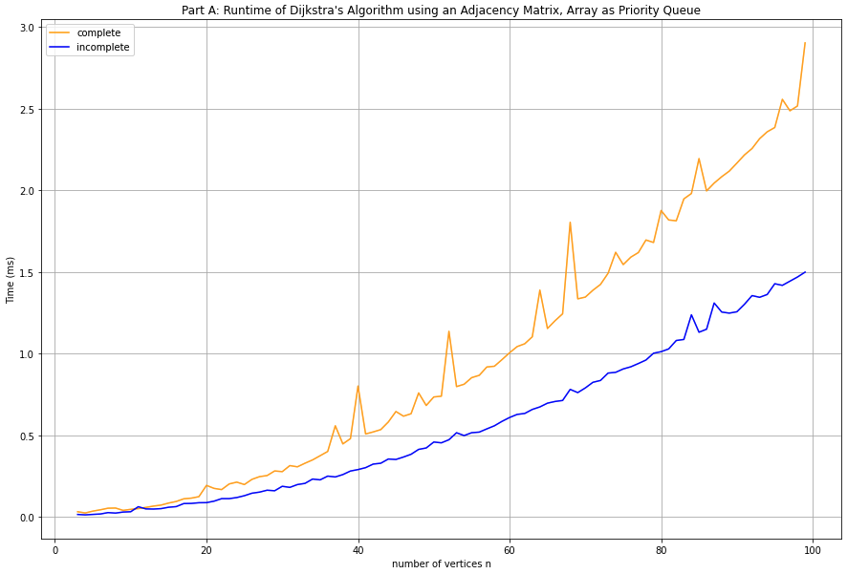
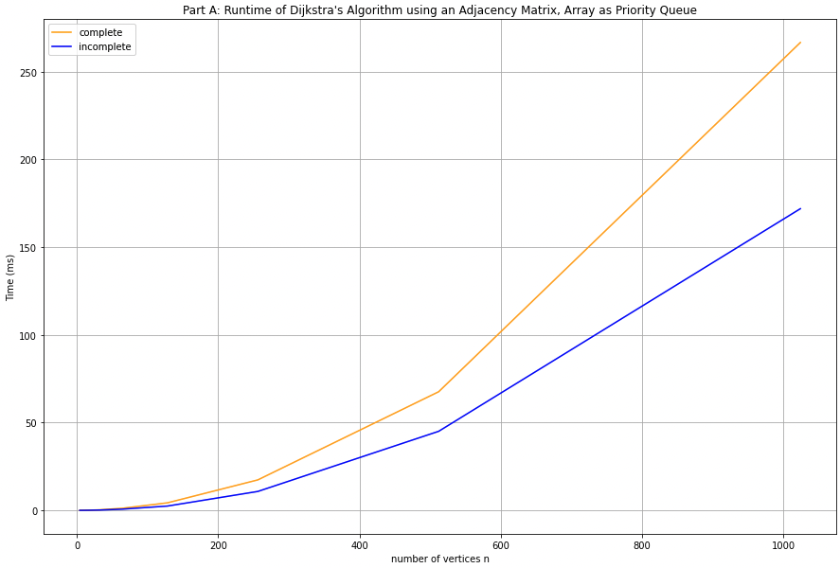
Part A: Dijkstra Algorithm with Array as PQ
Complete & Incomplete Graphs
n = 4 to 100
Complete & Incomplete Graphs
N = 4 to 1024

Slide 8
Part B
Input Graph stored in Adjacency Lists
Priority Queue: Minimizing Heap

Slide 9
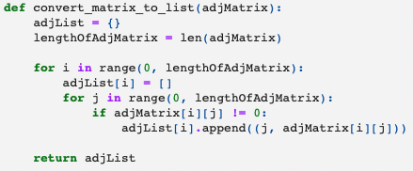
Part B: Random Adjacency Lists Graph Generator
Graphs are randomly generated Adjacency Matrices which is then converted to Adjacency Lists
n = no. of edges
e = no. of edges with weight

Slide 10
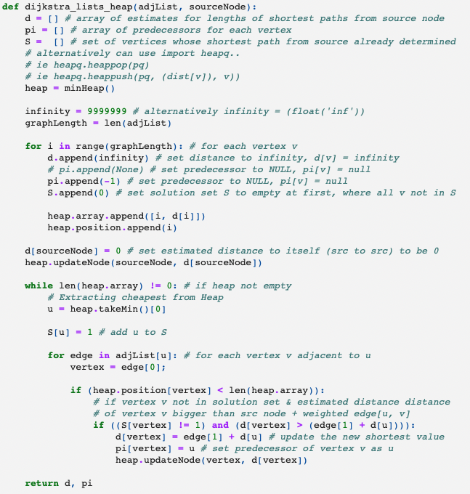
Part B: Dijkstra Algorithm with Min. Heap as PQ

Slide 11
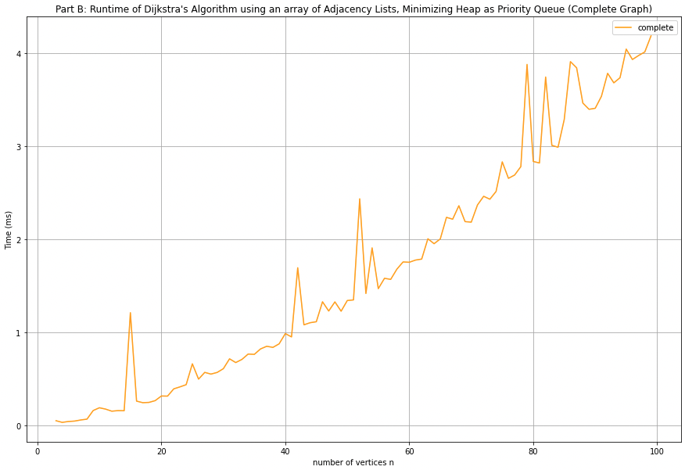
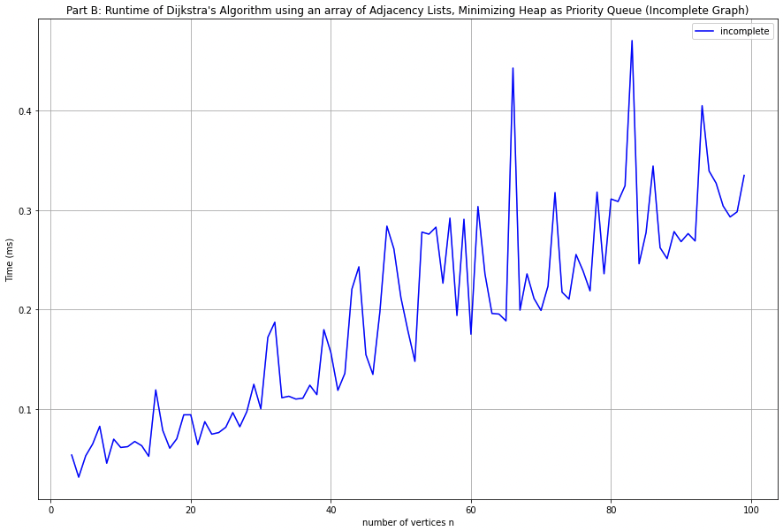
Part B: Dijkstra Algorithm with Min. Heap as PQ
Complete Graph
e = n * (n-1)
n = 4 to 100
Incomplete Graph
e = n + 1
N = 4 to 100

Slide 12
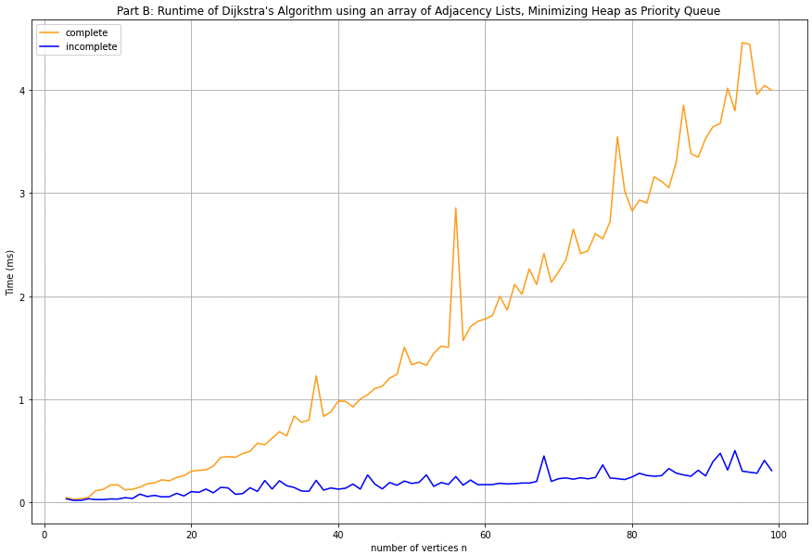
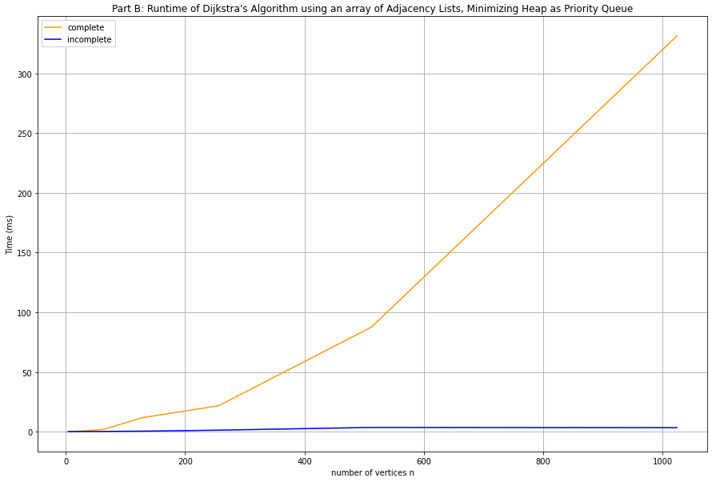
Part B: Dijkstra Algorithm with Min. Heap as PQ
Complete & Incomplete Graphs
n = 4 to 100
Complete & Incomplete Graphs
N = 4 to 1024

Slide 13
Part C.1
Comparing Part A & B of Dijkstra Algorithm
Part A: Array as PQ
Part B: Min Heap as PQ

Slide 14
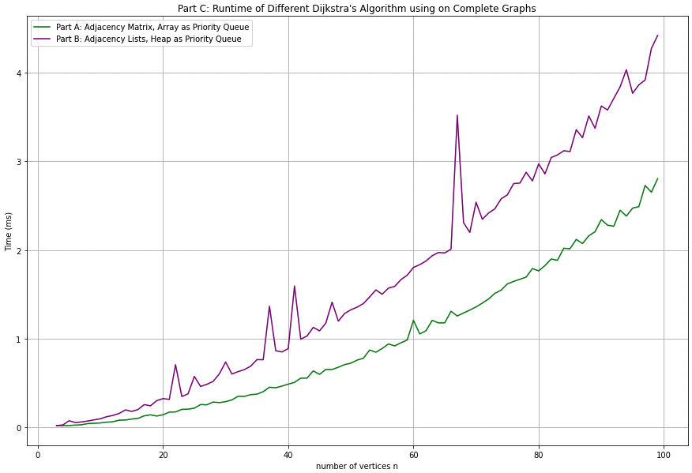
Part C: Comparing Different Dijkstra Algorithms
Complete Graph
e = n * (n-1)
n = 4 to 100

Slide 15
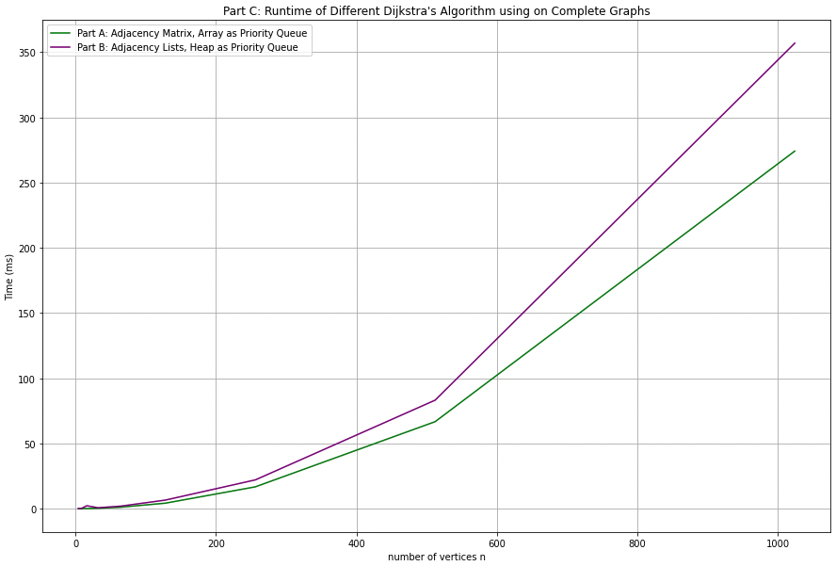
Part C: Comparing Different Dijkstra Algorithms
Complete Graph
e = n * (n-1)
n = 4 to 1024

Slide 16
Part C: Comparing Different Dijkstra Algorithms
Complete Graph (e = n * (n - 1))
Dijkstra Algorithm in Part A which utilizes an Adjacency Matrix & Array for the Priority Queue is more suitable for Complete Graphs:
Utilises Memory more Efficiently
Faster than Part B
CPU Time | Complete Graph
Part A: AdjMatrix with Array as PQ | 272.679ms
Part B: AdjList with MinHeap as PQ | 353.671ms
n = 1024. Lower is better.

Slide 17
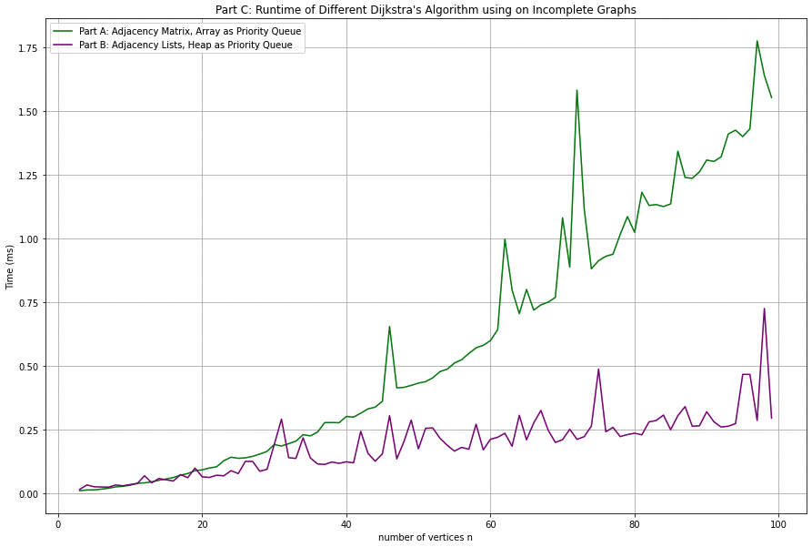
Part C: Comparing Different Dijkstra Algorithms
Incomplete Graph
e = n + 1
n = 4 to 100

Slide 18
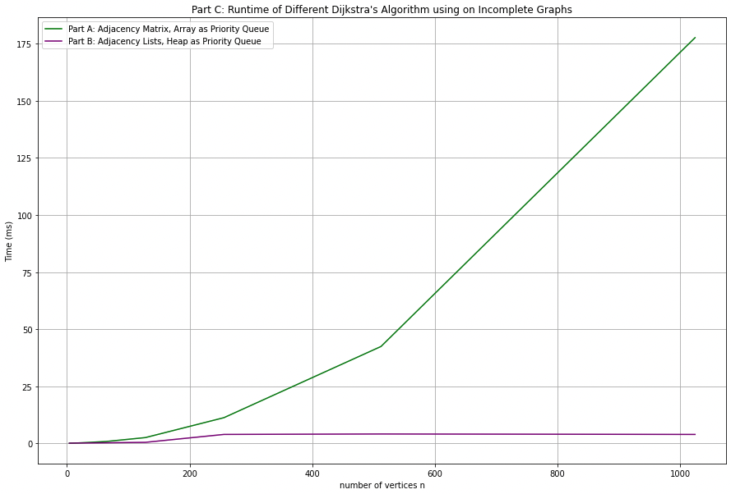
Part C: Comparing Different Dijkstra Algorithms
Incomplete Graph
e = n + 1
n = 4 to 1024

Slide 19
Part C: Comparing Different Dijkstra Algorithms
Incomplete Graph (e = n + 1)
Dijkstra Algorithm in Part B which utilizes an array of Adjacency Lists & Minimizing Heap for the Priority Queue is more suitable for Incomplete Graphs:
Lower Time Complexity of O(|V| log|V|) as opposed to a Time Complexity of O(|V|^2) in Part A
Lower Space Complexity of O(|V| + |E|)
CPU Time | Incomplete Graph
Part A: AdjMatrix with Array as PQ | ~171.27ms
Part B: AdjList with MinHeap as PQ | ~5.32ms
n = 1024. Lower is better.

Slide 20
Part C: Comparing Different Dijkstra Algorithms
Complete Graph (e = n * (n - 1))
Incomplete Graph (e = n + 1)
CPU Time | Incomplete Graph | Complete Graph
Part A: AdjMatrix with Array as PQ | ~171.27ms | 272.679ms
Part B: AdjList with MinHeap as PQ | ~5.32ms | 353.671ms
n = 1024. Lower is better.

Slide 21
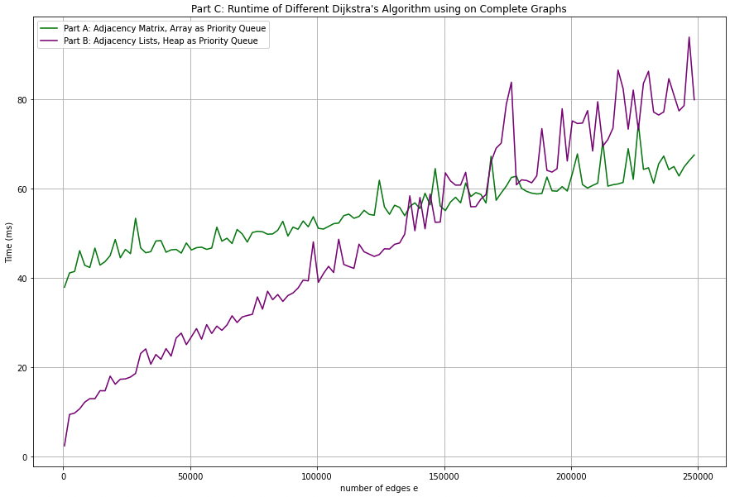
Part C: Comparing Different Dijkstra Algorithms
Incomplete to Complete Graph
e = 500 to 24500
Fixed n = 500

Slide 22
Part C: Comparing Different Dijkstra Algorithms
Incomplete to Complete Graph
e = 500 to 24500
Fixed n = 500
While Part B started out quicker, it is quickly overtaken.
Part A appears to not be affected by e, while Part B increases quickly as e increases.
Conclusion: Use Part B Dijkstra Algorithm with Adjacency Lists & Heap as PQ if the number of edges is low (ie towards an Incomplete Graph)

Slide 23
Part C.2
Time Complexity of Part A Dijkstra Algorithm using Array as Priority Queue
Time Complexity of Part B Dijkstra Algorithm using Min Heap as Priority Queue

Slide 24
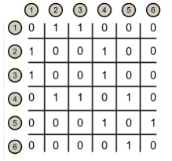
Part C: Time Complexity with Part A, Array as PQ
Iterates through all vertices
Select vertex with the minimum distance
Insert into priority queue
Array as Priority Queue
Transversal using Adjacency Matrix = V x (no. of edges each vertex is connected to) = V x (V - 1) = V² - V = O(|V|²)
Implementation of Array as Priority Queue = O(1) as Insertion into Array is Constant Time
Overall Time Complexity = O(|V|² + 1) = O(|V|²)

Slide 25
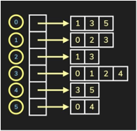
Part C: Time Complexity with Part B, Min. Heap as PQ
Iterates through vertices
Looks through adjacency list for shortest distance
Insertion into heap (heapify)
Minimizing Heap as Priority Queue
Transversal using Adjacency Matrix = O( |E| + |V| )
Implementation of Heap as Priority Queue = O( log (|V|) )
Overall Time Complexity = O( |E| + |V| ) * O( log (|V|) ) = O( |E| + |V| ) log (|V|) = O( |E| log (|V|) + |V| log (|V|) ) = O(|E| log (|V|) )
Notes:
Time Complexity: The time complexity of the above code/algorithm looks O(V^2) as there are two nested while loops. If we take a closer look, we can observe that the statements in the inner loop are executed O(V+E) times (similar to BFS). The inner loop has decreaseKey() operation which takes O(LogV) time. So overall time complexity is O(E+V)*O(LogV) which is O((E+V)*LogV) = O(ELogV)
Note that the above code uses Binary Heap for Priority Queue implementation. Time complexity can be reduced to O(E + VLogV) using Fibonacci Heap. The reason is, that Fibonacci Heap takes O(1) time for decrease-key operation while Binary Heap takes O(Logn) time.

Slide 26
Thank You!
Q & A

Slide 27
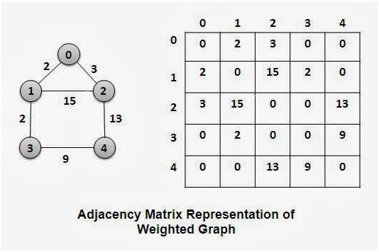
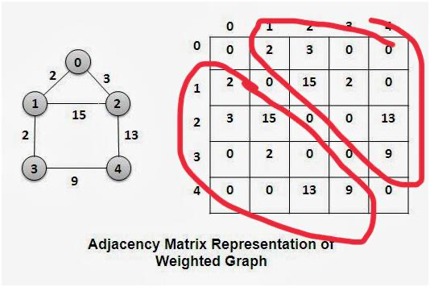
BELOW SLIDES ARE WRONG
CHANGED COMPLETE EDGES FROM
e = n*(n-1) TO e = (n*(n-1))/2
e = (n*(n-1))/2 BUT e = n*(n-1) for adjMatrix for graph as there are 2 triangle mirrors

Slide 28
2 Types of Graphs
Complete Graph
e = (n * (n - 1)) / 2, where e is the maximum number of edges a graph can have
Incomplete Graph
e = n + 1

Slide 29
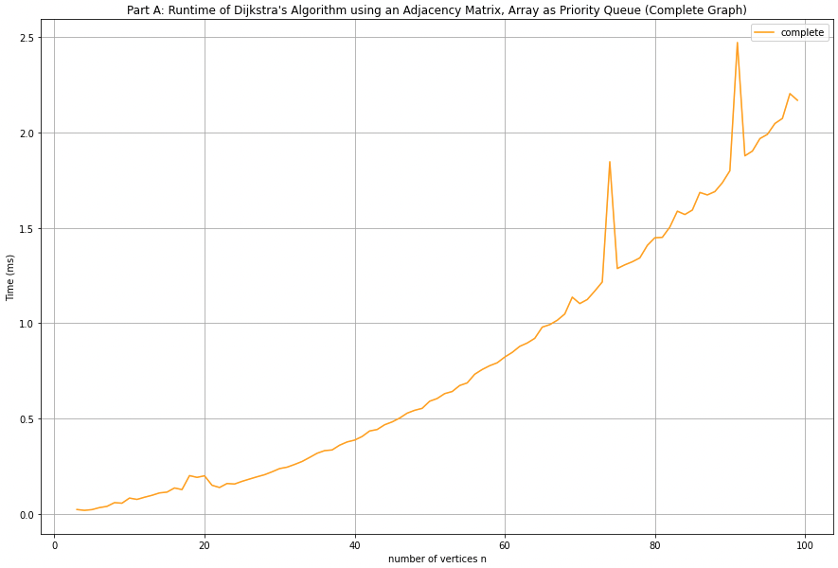
Part A: Dijkstra Algorithm with Array as PQ
Complete Graph
e = (n * (n - 1)) / 2
n = 4 to 100
Incomplete Graph
e = n + 1
N = 4 to 100

Slide 30
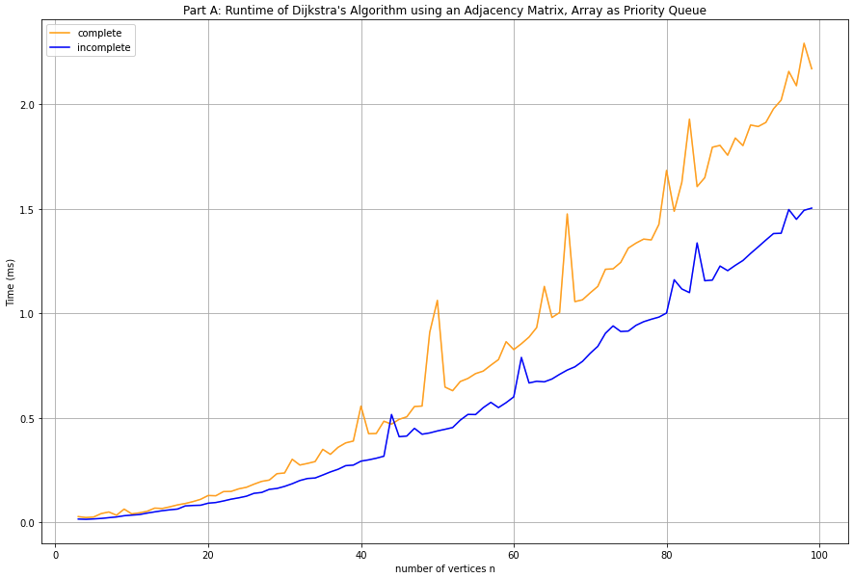
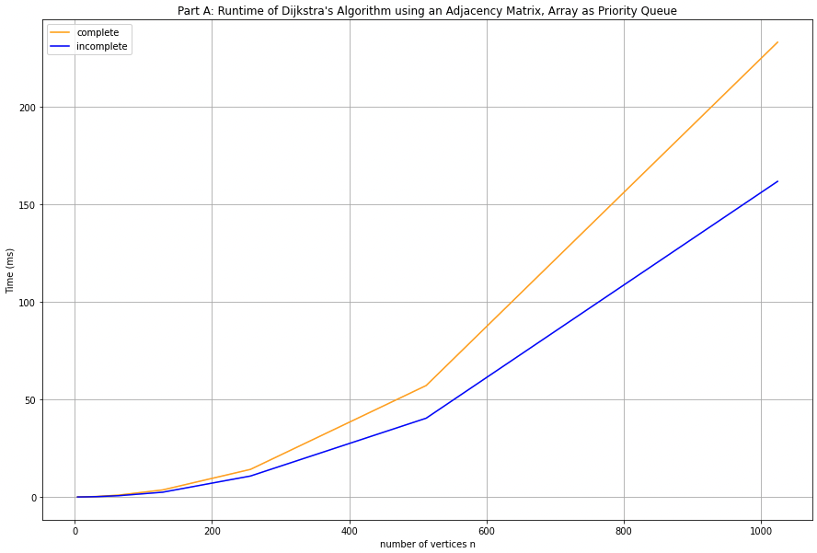
Part A: Dijkstra Algorithm with Array as PQ
Complete & Incomplete Graphs
n = 4 to 100
Complete & Incomplete Graphs
N = 4 to 1024

Slide 31
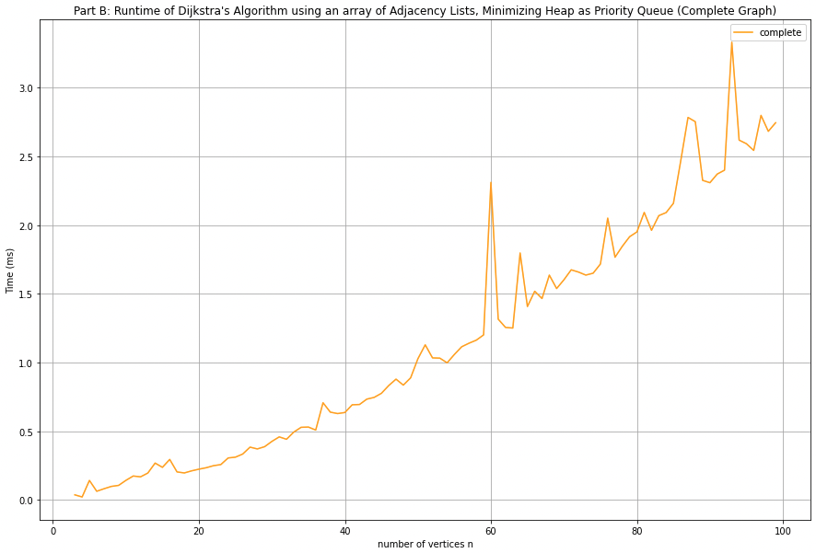
Part B: Dijkstra Algorithm with Min. Heap as PQ
Complete Graph
e = (n * (n - 1)) / 2
n = 4 to 100
Incomplete Graph
e = n + 1
N = 4 to 100

Slide 32
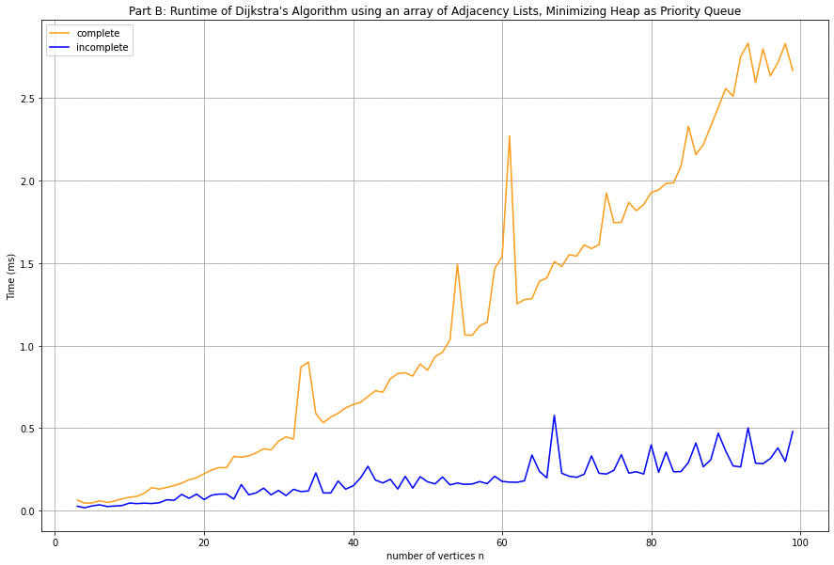
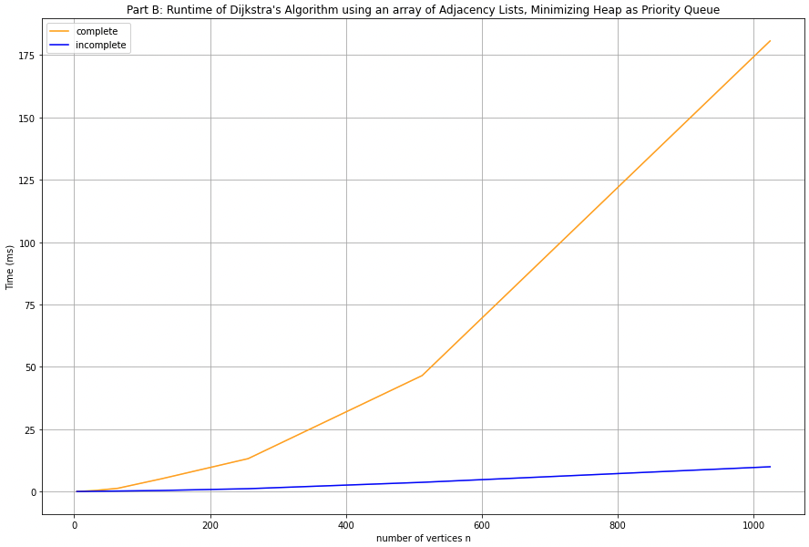
Part B: Dijkstra Algorithm with Min. Heap as PQ
Complete & Incomplete Graphs
n = 4 to 100
Complete & Incomplete Graphs
N = 4 to 1024

Slide 33
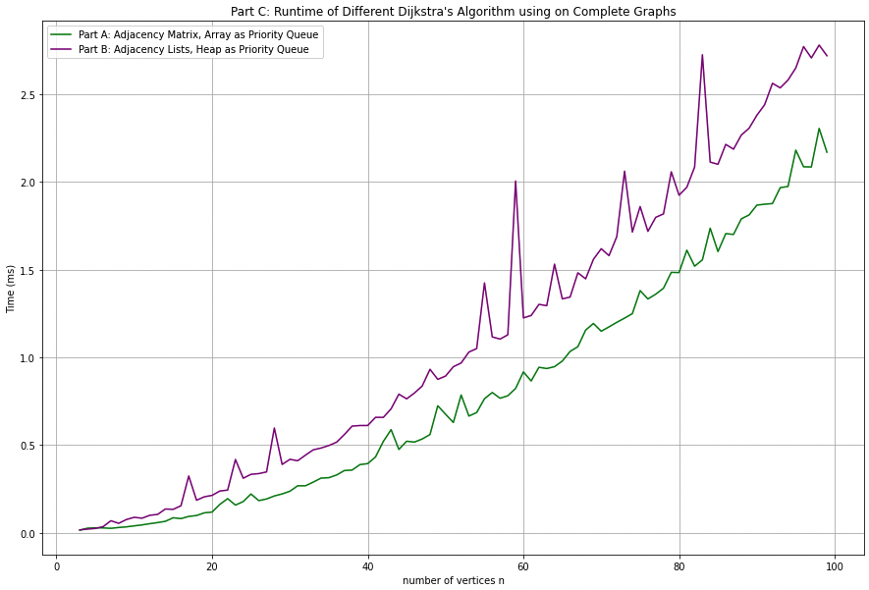
Part C: Comparing Different Dijkstra Algorithms
Complete Graph
e = (n * (n - 1)) / 2
n = 4 to 100

Slide 34
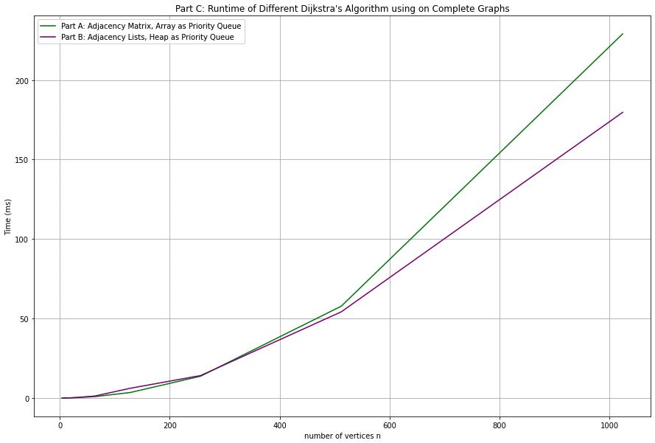
Part C: Comparing Different Dijkstra Algorithms
Complete Graph
e = (n * (n - 1)) / 2
n = 4 to 1024

Slide 35
Part C: Comparing Different Dijkstra Algorithms
Complete Graph (e = n * (n - 1) / 2 )
Dijkstra Algorithm in Part A which utilizes an Adjacency Matrix & Array for the Priority Queue is more suitable for Complete Graphs:
Utilises Memory more Efficiently
Faster than Part B

Slide 36
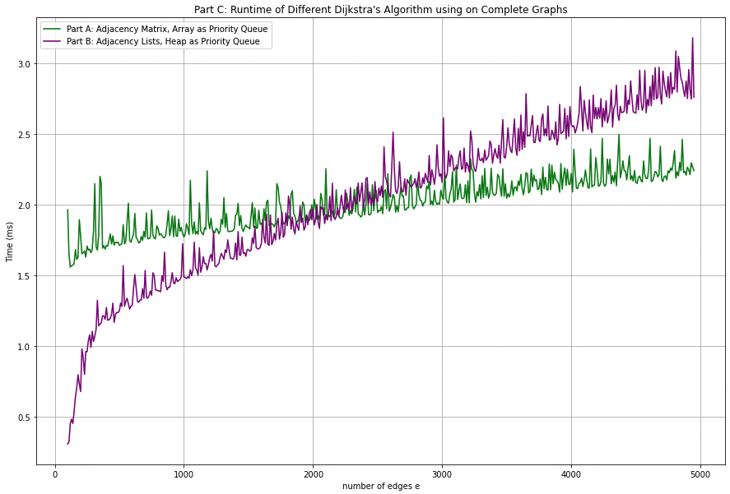
Part C: Comparing Different Dijkstra Algorithms
Incomplete to Complete Graph
e = 100 to 4950
Fixed n = 100

Slide 37
Part C: Comparing Different Dijkstra Algorithms
Incomplete to Complete Graph
e = 100 to 4950
Fixed n = 100
While Part B started out quicker, it is quickly overtaken.
Part A appears to not be affected by e, while Part B increases quickly as e increases.
Conclusion: Use Dijkstra Algorithm with Adjacency Lists & Heap as PQ if the number of edges is low (ie towards an Incomplete Graph)

Slide 38
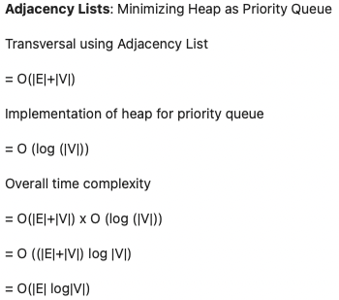
Part C: Time Complexity with Part B, Min. Heap as PQ
Iterates through vertices
Looks through adjacency list for shortest distance
Insertion into heap (heapify)
Notes:
Time Complexity: The time complexity of the above code/algorithm looks O(V^2) as there are two nested while loops. If we take a closer look, we can observe that the statements in the inner loop are executed O(V+E) times (similar to BFS). The inner loop has decreaseKey() operation which takes O(LogV) time. So overall time complexity is O(E+V)*O(LogV) which is O((E+V)*LogV) = O(ELogV)
Note that the above code uses Binary Heap for Priority Queue implementation. Time complexity can be reduced to O(E + VLogV) using Fibonacci Heap. The reason is, that Fibonacci Heap takes O(1) time for decrease-key operation while Binary Heap takes O(Logn) time.

